Slide 1
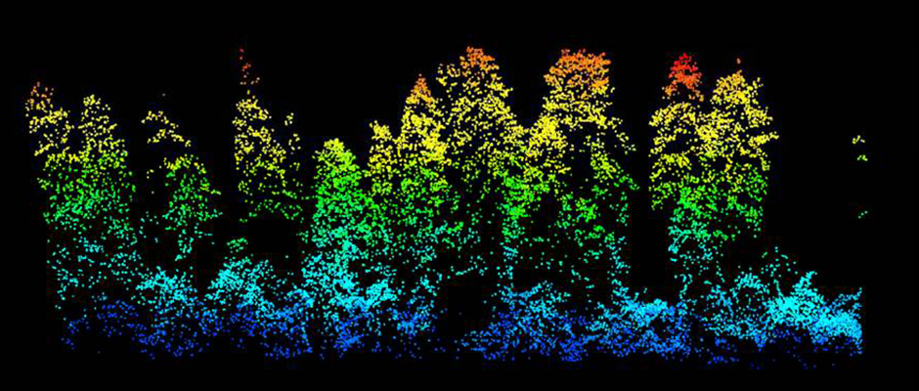
forest3D
David Diaz, Martin Bagaram, Zhehao Li
wildlife.org

Slide 2
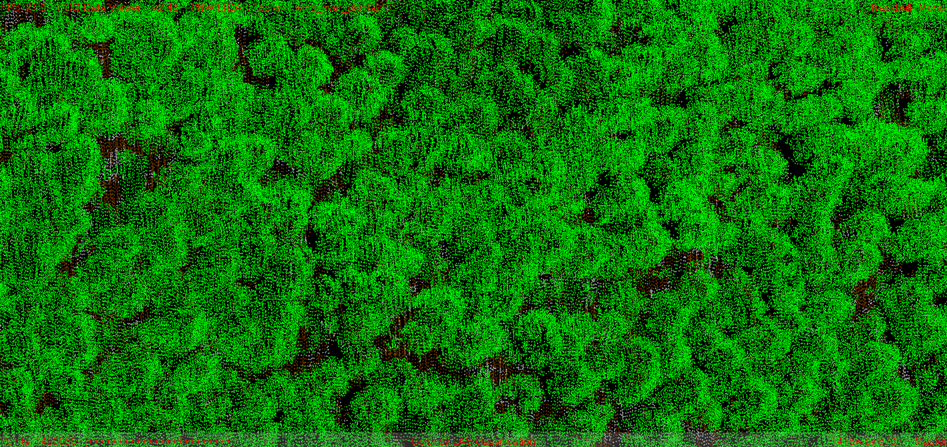
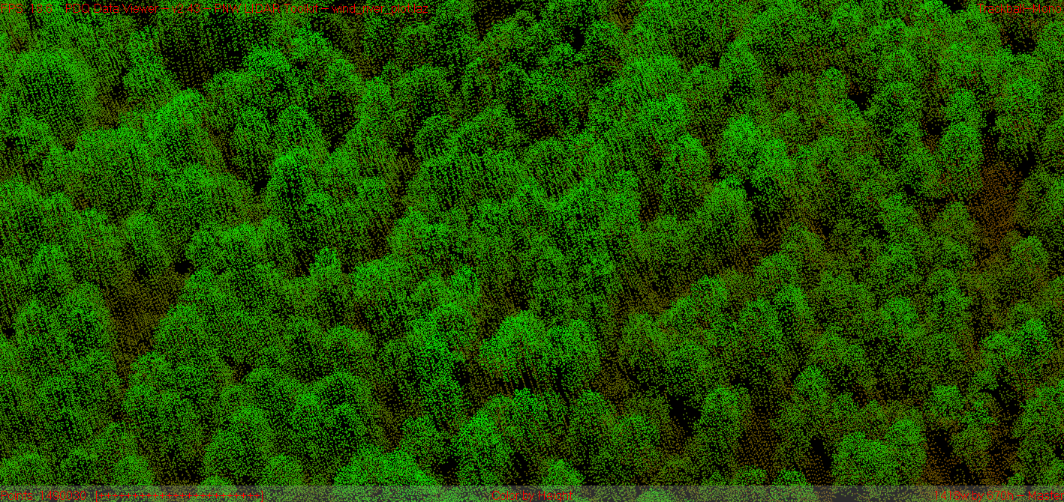

Slide 3
Expectations by the due date
Finish building a tree model to include stems
Visualize a list of trees from the dataset
Run more test coverages for some edge cases
Develop the optimization module
If time allows ☺

